Slide 1
OLIST STORE DATA ANALYSIS
PRESENTATION

Slide 2
Datasets
Domain : P 578 E-Commerce
Project Name: Olist Store Analysis
Dataset Name: Total 9 files
Dataset Type: CSV Data
Dataset Zip Folder Size: 45 MB

Slide 3
Weekday Vs Weekend (order_purchase_timestamp) Payment Statistics
Number of Orders with review score 5 and payment type as credit card.
Average number of days taken for order_delivered_customer_date for pet_shop
Average price and payment values from customers of sao paulo city
Relationship between shipping days (order_delivered_customer_date - order_purchase_timestamp) Vs review scores.
KPI’s

Slide 4
INTRODUCTION
This exercise is aimed at effective utilisation of
various Business intelligence tools
to create easily understandable visuals and
to Analyse the Olist Store Dataset
with respect to the Key performance Indicators(KPI’s)
in order to derive meaningful insights
for enhancing the business performance.

Slide 5
KEY HIGHLIGHTERS
Total No of Sellers
Total No of customer city
No of Customer States
3095
419
27
Products: 74
Orders: 99441
Payment : $16008872

Slide 6
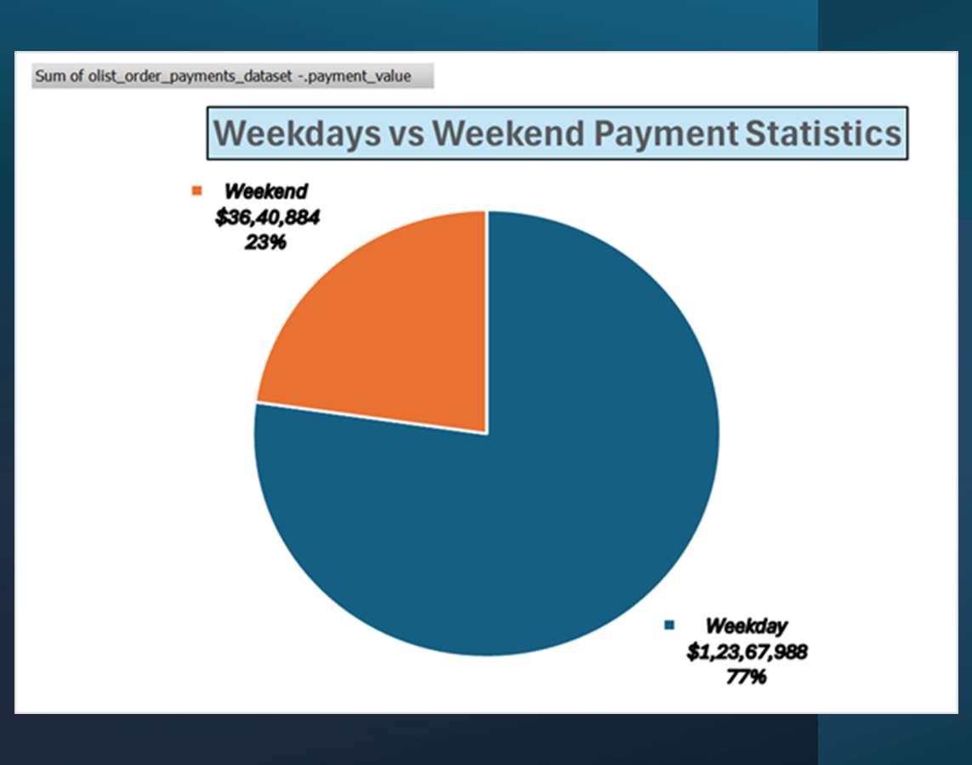
Weekly Sales Trend
The pie chart shows the customer habits of buying products,
The Sales in weekdays is 77% of the Total Sales and
The sales in Weekend is 23% of Total sales
More sales in weekdays in comparison to Weekend shows that people spend time in other activities in weekends in addition to shopping.

Slide 7
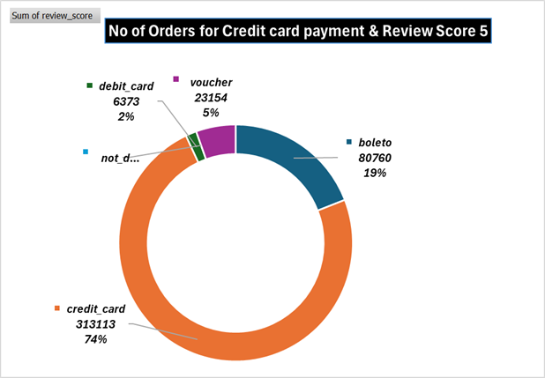
Payment type vs no of orders
Review score in the scale of 1 to 5 is given to the orders based on various factors
Highest Score of 5 is given for minimum delivery time
For review score 5, a total of 74% of orders are placed on credit card payment.

Slide 8
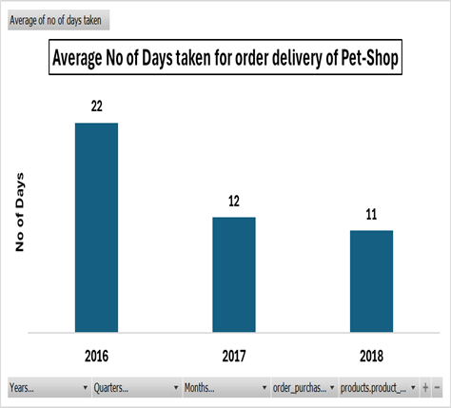
The average shipping days for Pet_shop decreases from 22 to 11 from year 2016 to 2018. This shows the efficiency of shipping is increasing year by year.

Slide 9
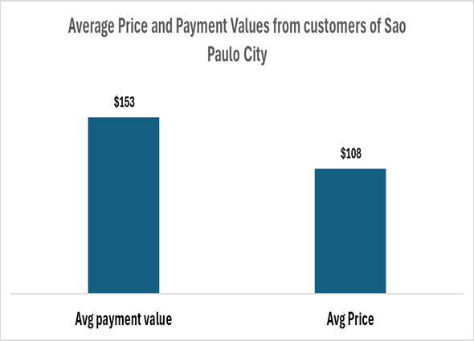
Sales in Sao paulo city
Average price of a product in Sao paulo city is $108
Average payment of a product in Sao paulo city is $153
Therefore,Average profit per product in Sao paulo city is $ 45

Slide 10
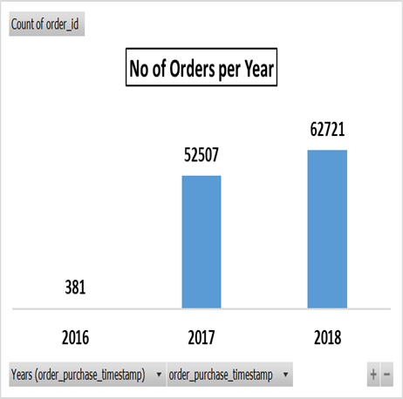
No of orders per year
The No of orders is increasing every year from 2016 to 2018
This shows the increasing trend in demand of the products

Slide 11
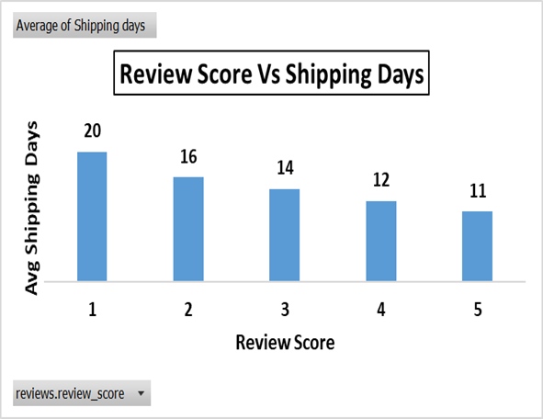
Review score and shipping days
Review Score in the scale of 1 to 5 is awarded to products ordered.
As the shipping days decreases, review score increases
For lowest review score of 1, the avg shipping day is 20
For the highest review score of 5, the avg shipping days is 11.

Slide 12
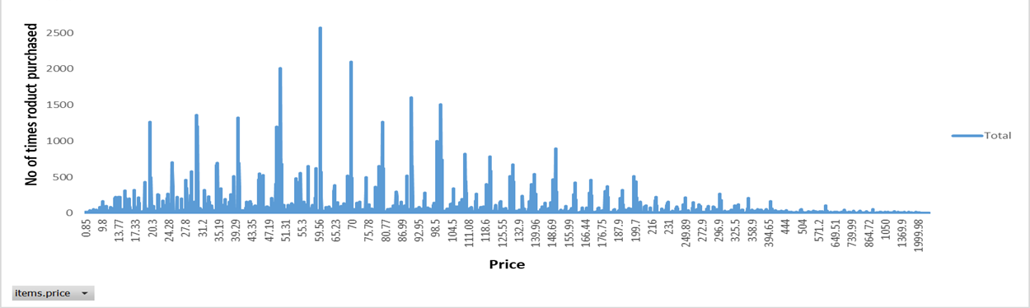

No of repeat orders for products decreases with increase in price. The repeat orders are maximum for price between 20 and 100.
Relationship between price and no of repeat orders of a product

Slide 13
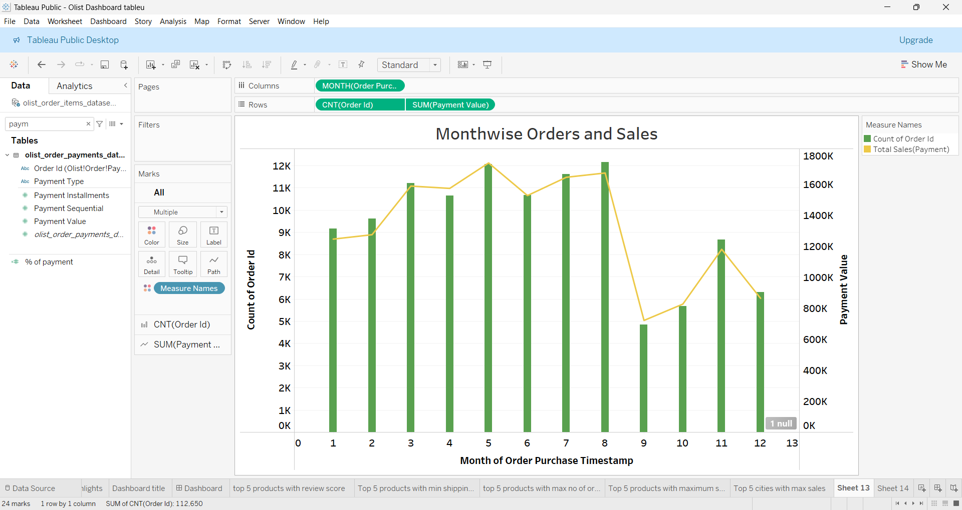
Monthwise Orders and Sales (Best Period-January to August)

Slide 14
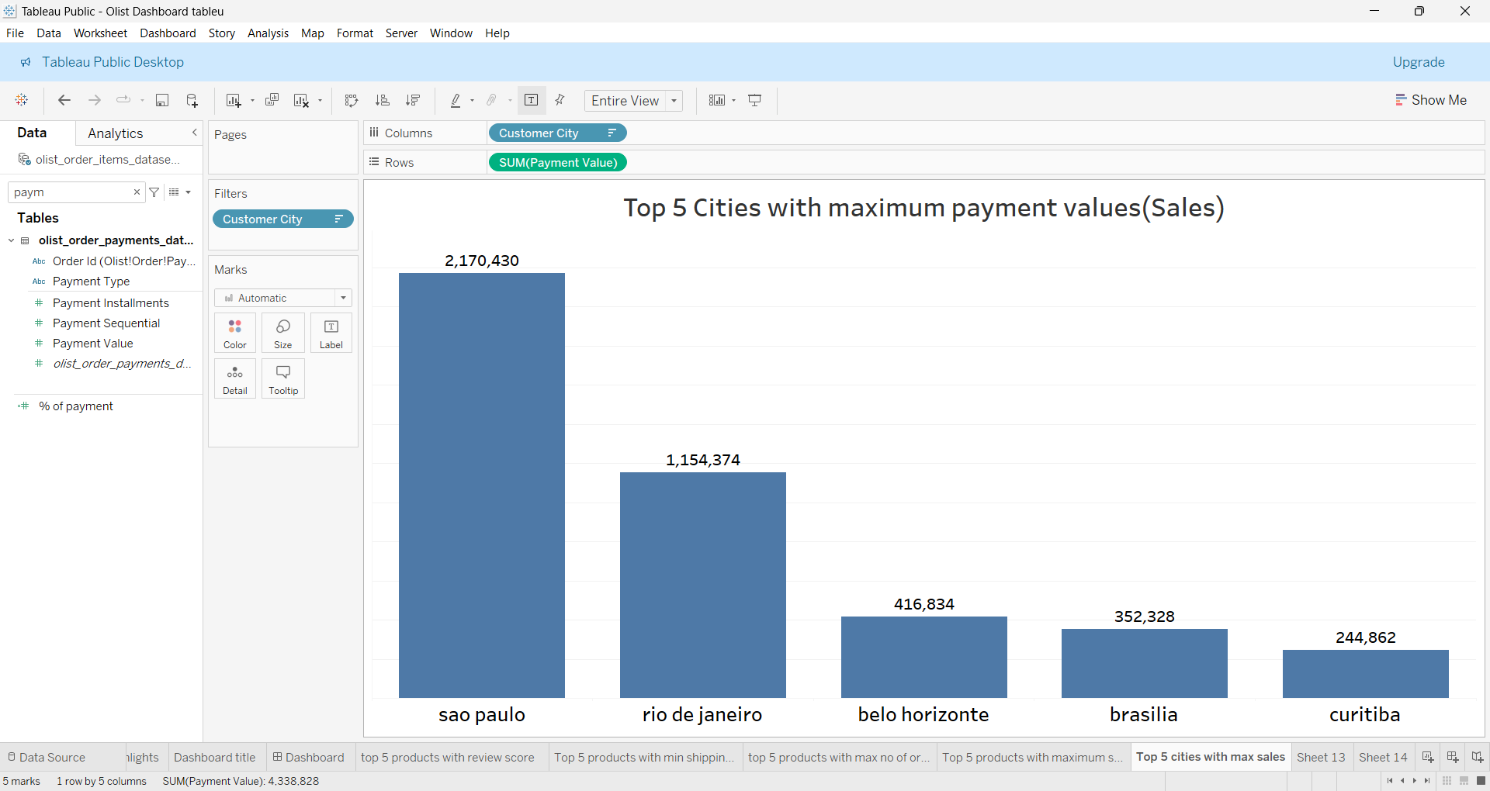

Top 5 Cities with maximum Sales
1. Sao Paulo
2. Rio de Janeiro
3. Belo Horizonte
4. Brasilia
5. Curitiba

Slide 15
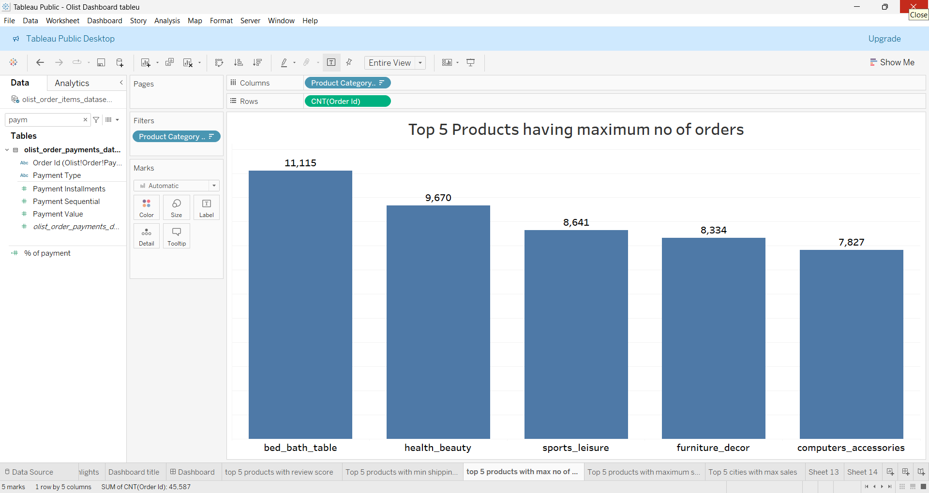
Top 5 Products having maximum Orders
1.Bed_bath_table
2.Health_beauty
3.Sports_Leisure
4.Furniture_Decore
5.Computer Accessories

Slide 16
EXCEL DASHBOARD
Notes:
EXCEL DASHBOARD

Slide 17
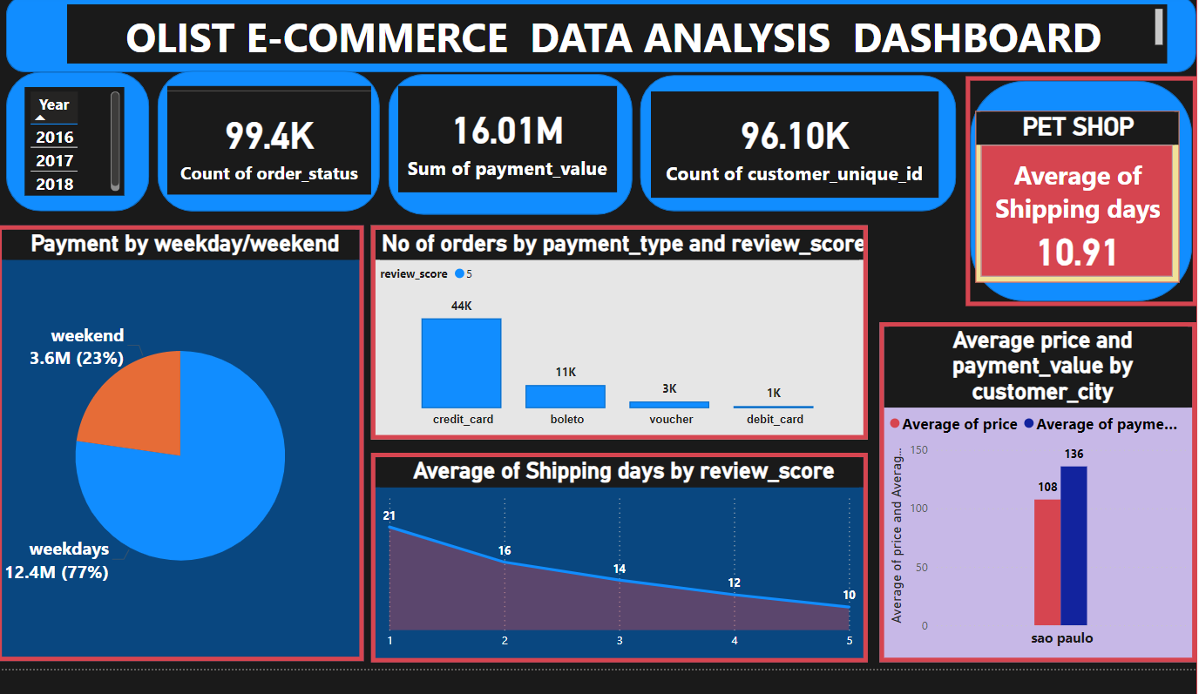
POWER BI DASHBOARD
Notes:
POWER BI DASHBOARD

Slide 18
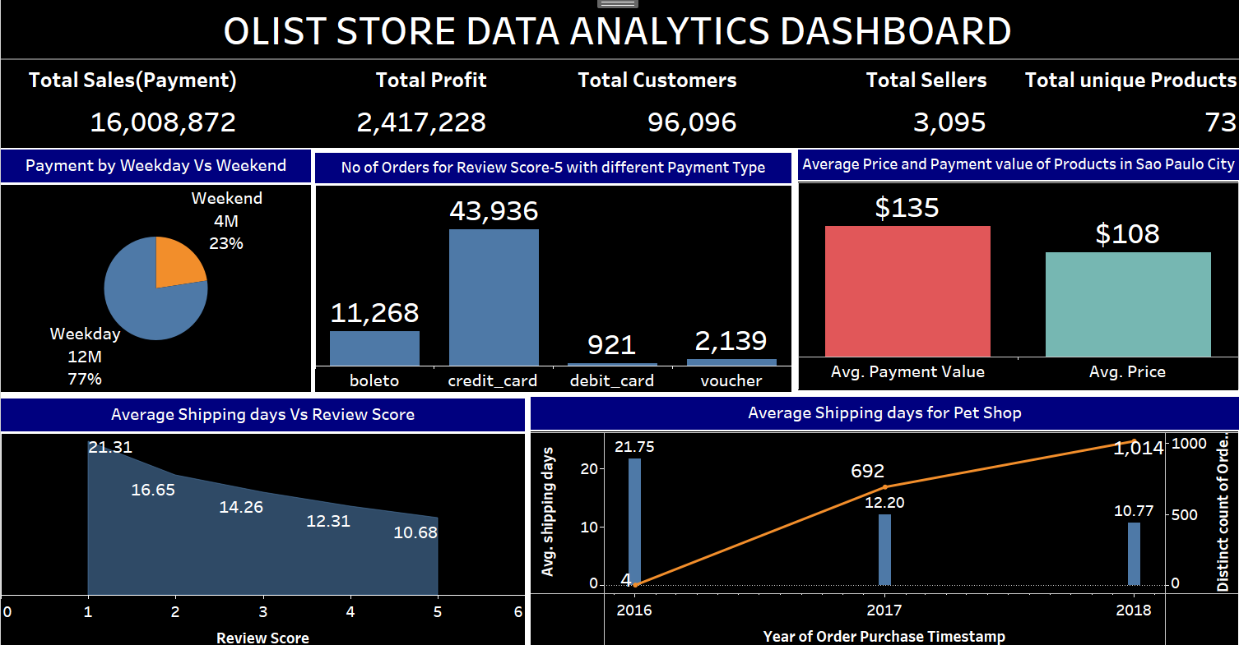
TABLUE DASHBOARD
Notes:
TABLUE DASHBOARD

Slide 19
CONCLUSION
Customer purchasing behaviour shows that more orders are placed in weekdays than weekends.
Additional Focus may be given to weekday orders for maximising sales.
The repeat orders are more for products having price between $20 and $100.
Maximum orders are placed by credit card payments.
Extra Focus recommended to Credit card payments and Product price $20 to $100 for maximum repeat orders .
As the review score increases the shipping days decreases.
Owner should focus on products with higher review score so that the shipping time decreases and there would be more turnover.

Slide 20
THANK YOU

